Slide 1
Introduction to network analysis
Amit Kohli
amitkohli.com

Slide 3
Road map

Slide 4
Basics

Slide 5
What is Network Analysis?
… the layman’s version
A self-organizing
map of useful relationships
A UNIVERSE!
Own terminology
Own theory (graph)
Own database
Own analysis & modelling
strategies
R CODE!!!
install.packages(c('igraph', 'visNetwork', 'igraphdata')
library(igraph); library(visNetwork); library(igraphdata)

Slide 6
GEOGRAPHICAL Map
Relationships are unaffected by other entities
Position matters

Slide 7
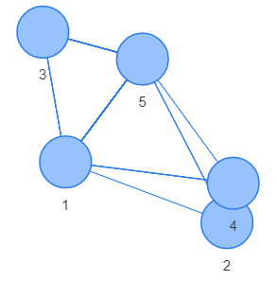
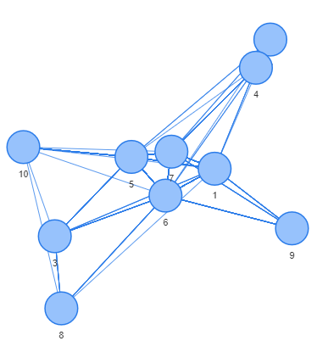
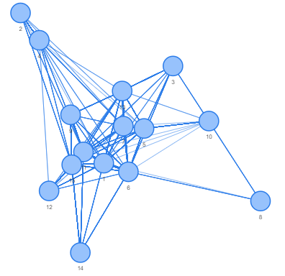
Network Map
RFID hospital encounter network
(first 5 nodes / first 10 nodes / first 15)

Slide 8
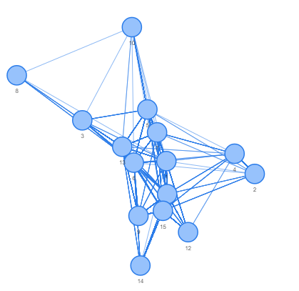
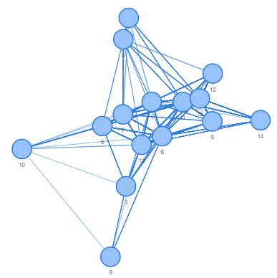
SHAPE NOT IMPORTANT. WELL IT IS, BUT...
First 15 nodes of rfid network, plotted 3 times

Slide 9
A BIT OF NOMENCLATURE…
Edge
Node
(Vertex)

Slide 10
SELECTED Tech
R packages
igraph
visNetwork
tidygraph
Many more! See task view
Other than R…
Gephi
neo4j

Slide 11
Data from…
graph_from_adjacency_matrix | Create graphs from adjacency matrices
graph_from_adj_list | Create graphs from adjacency lists
graph_from_atlas | Create a graph from the Graph Atlas
graph_from_data_frame | Creating igraph graphs from data frames or vice-versa
graph_from_edgelist | Create a graph from an edge list matrix
graph_from_incidence_matrix | Create graphs from an incidence matrix
graph_from_isomorphism_class | Create a graph from an isomorphism class
graph_from_lcf | Creating a graph from LCF notation
graph_from_literal | Creating (small) graphs via a simple interface
## These are all igraph funcs :). TL;WR – If you have a TO and FROM you’re good

Slide 12
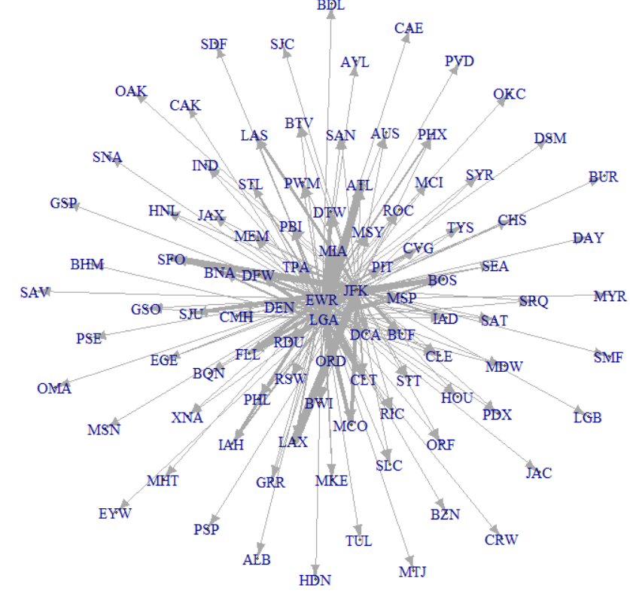
EASY EXAMPLE - nycflights13::flights
library(nycflights13); library(dplyr)
g <- flights %>%
select(origin, dest) %>%
graph_from_data_frame(.)
g %>% plot
E(g)$weight <- 1
g <- g %>% simplify(edge.attr.comb="sum")
E(g)$width <- E(g)$weight / max(E(g)$weight) * 10
g %>%
plot(vertex.size = 1,edge.arrow.size = .3, layout = layout.graphopt)

Slide 13
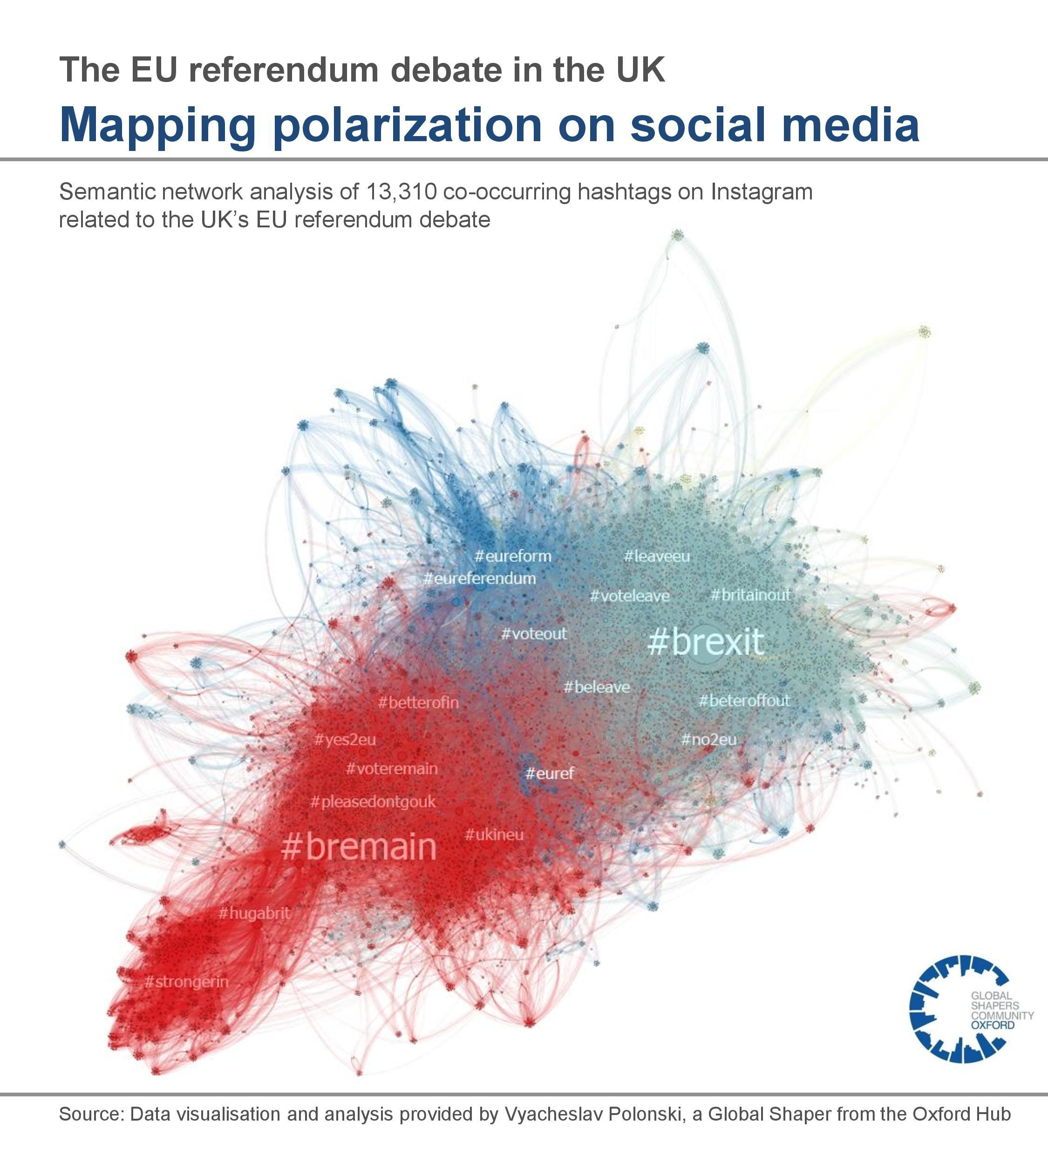
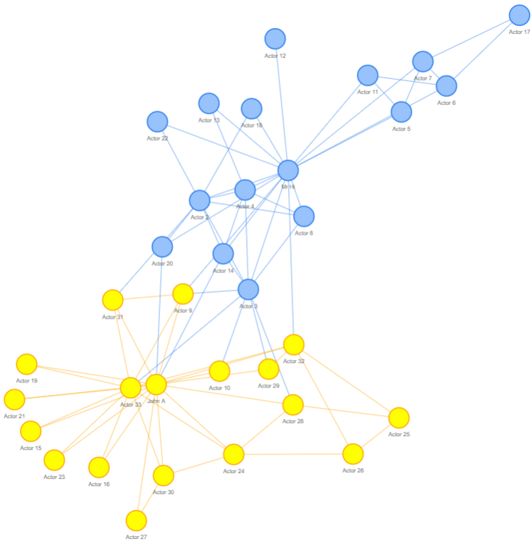
examples
Zachary's karate club
data(karate)
visIgraph(karate)

Slide 15
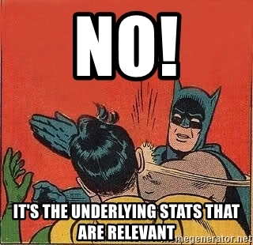

Slide 16
NETWORK STATISTICS

Slide 17
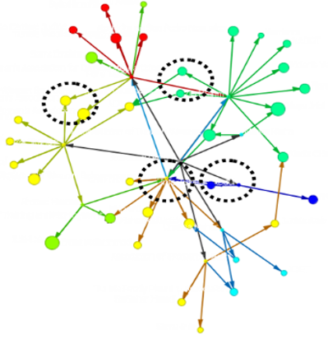
NETWORK STATISTICS!!!
Look at
WHOLE NETWORK
Or the
INDIVIDUAL NODES

Slide 18
WHOLE NETWORk stats

Slide 19
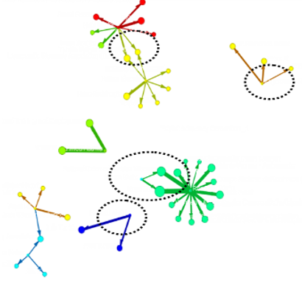
Fragmentation
data(yeast)
count_components(yeast)

Slide 20
Community Detection
data(karate)
ebc <- cluster_walktrap(as.undirected(karate))
memb <- membership(ebc)
plot(as.undirected(karate), vertex.color=memb, vertex.label=NA)

Slide 21
SHORTEST PATH LENGTH
1
1.761905
1
g <- make_star(10, mode = "out")
mean_distance(g, directed = TRUE)

Slide 22
Individual node stats

Slide 23
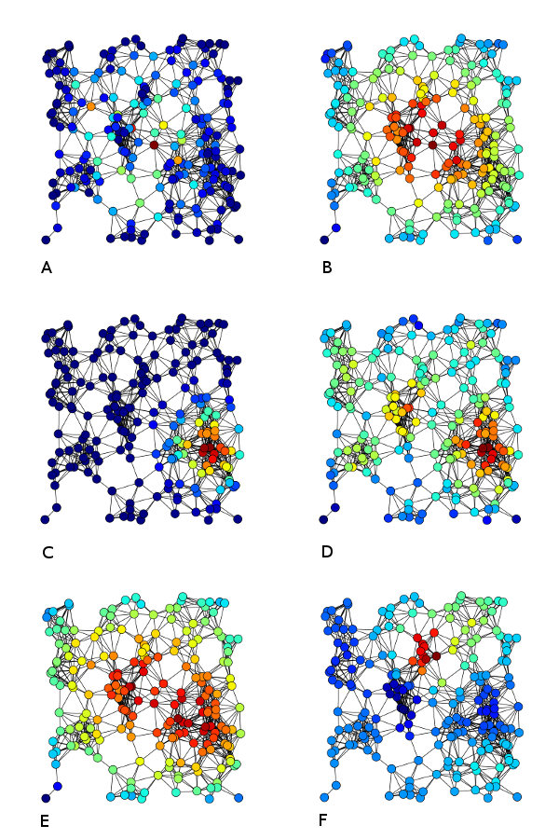
Centrality
How “middley” are you?
Betweenness centrality Closeness centrality
Eigenvector centrality Degree centrality
Harmonic centrality Katz centrality
alpha_centrality | Find Bonacich alpha centrality scores of network positions
authority_score | Kleinberg's authority centrality scores.
betweenness | Vertex and edge betweenness centrality
bonpow | Find Bonacich Power Centrality Scores of Network Positions
closeness | Closeness centrality of vertices
edge_betweenness | Vertex and edge betweenness centrality
eigen_centrality | Find Eigenvector Centrality Scores of Network Positions
hub_score | Kleinberg's hub centrality scores.
power_centrality | Find Bonacich Power Centrality Scores of Network Positions
subgraph_centrality | Find subgraph centrality scores of network positions
g <- make_star(10, mode = "out")
eigen_centrality(g)
https://en.wikipedia.org/wiki/Centrality#

Slide 24
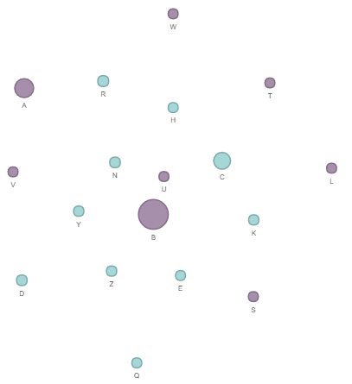
USE CENTRALITY TO IDENTIFY KEY NODES
Purple nodes are producers
You can “help” one, preferably a strong one
Who do you help to maximize your effect on everybody?

Slide 25
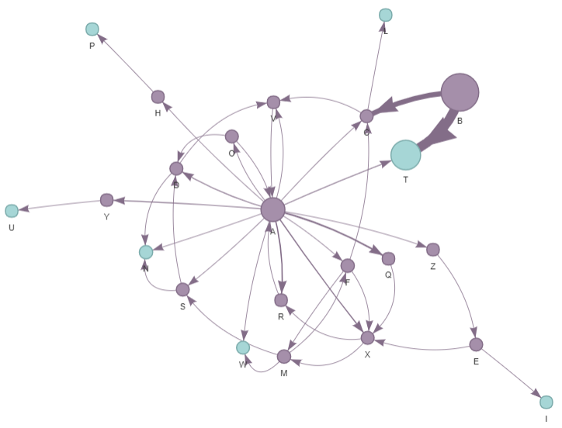
More important
Less important

Slide 26
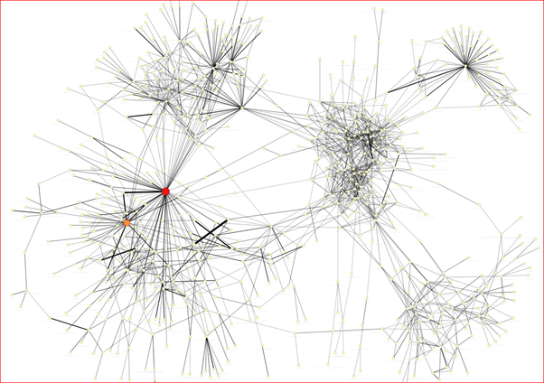
Authority/HUB
Authority is the “global buyer”, where everything points in
Degrees IN, but considers the node “importance”
Opposite is “Hub”
g <- make_full_citation_graph(100)
authority_score(g)$vector
hub_score(g)$vector

Slide 27
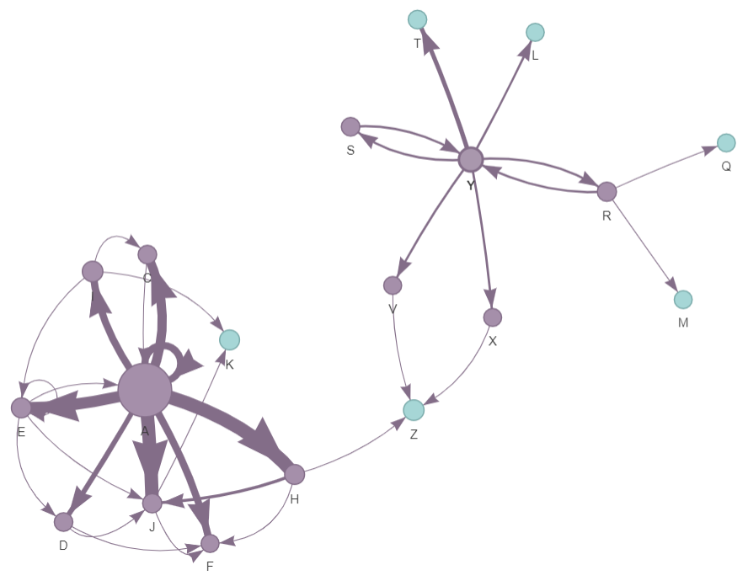
degrees IN/OUT
“groups of 6”
DEGREES = 4
DEGREES IN = 1
DEGREES OUT = 3
g <- make_full_citation_graph(100)
degree(g, mode = "in")

Slide 28
Bridge
library(networktools)
graph1 <- qgraph::qgraph(cor(depression))
bridge(graph1, communities=c('1','1','2','2','2','2','1','2','1'))

Slide 29
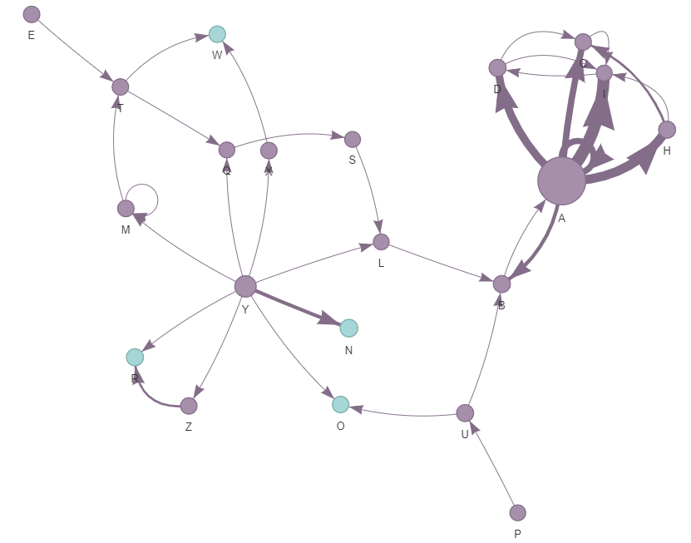
IDENTIFY the “bottleneck”
Create new
connections?
Bottleneck

Slide 30
What can I do with these numbers?
Export to data warehouse
Use as ML features
Quantify intervention before/after
Independent observations?

Slide 31
CASE STUDIES

Slide 32
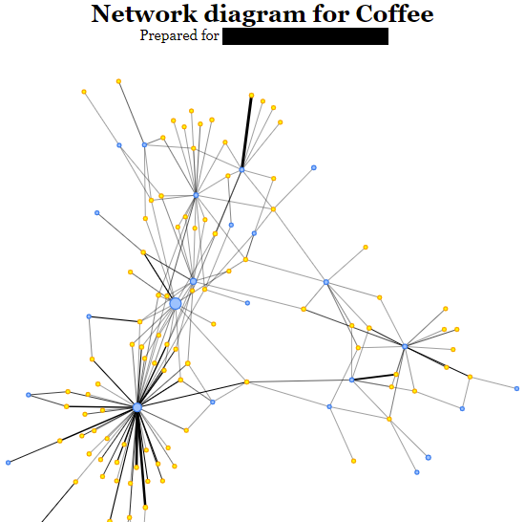
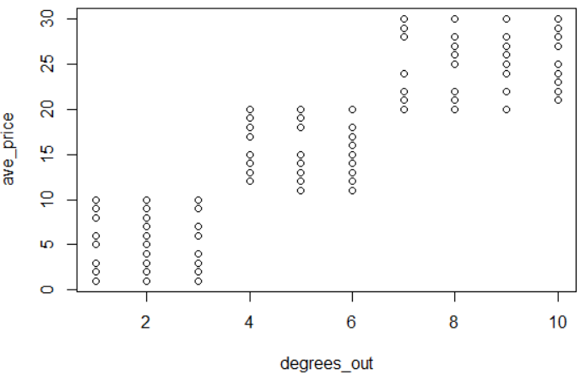
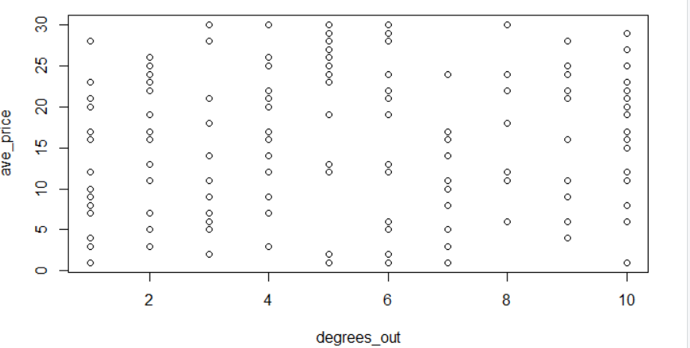
DEGREES out vs PRICE
Buyer
Village

Slide 33
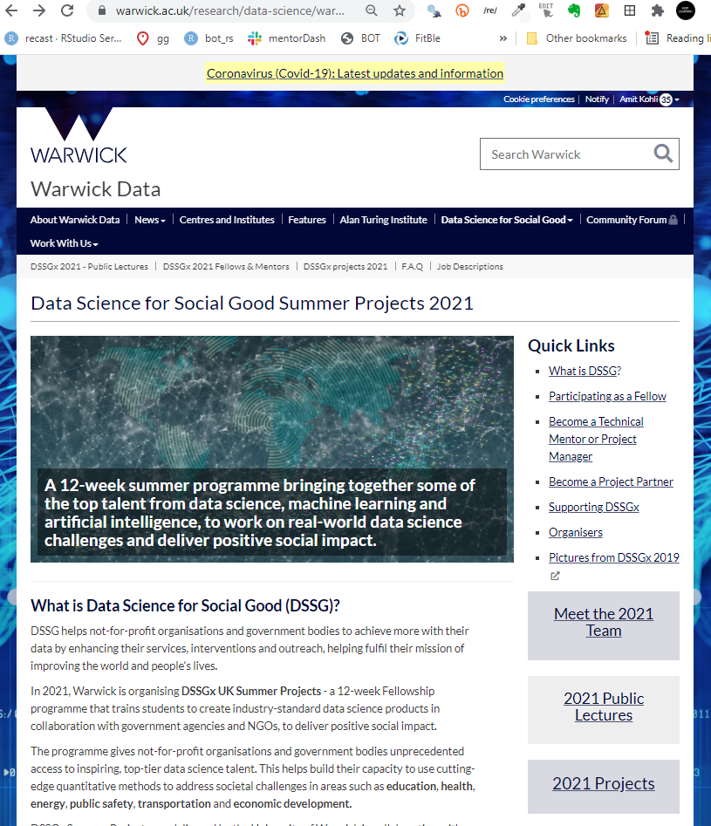

Slide 34
From | To
Page 1 | Page 2
Page 1 | Page 3
Page 2 | Page 4
Page 2 | Page 5
Page 3 | Page 4
Page 3 | Page 6
Page 6 | Page 1
Page 5 | Page 4
1
3
4
2

Slide 35
From | To
Page 1 | Page 2
Page 1 | Page 3
Page 2 | Page 4
Page 2 | Page 5
Page 3 | Page 4
Page 3 | Page 6
Page 6 | Page 1
Page 5 | Page 4
Page 2
Page 4
Page 1
Page 5
Page 3
Page 6

Slide 36
Compare website architecture path to user journey…

Slide 37
Slackoverflow questions

Slide 38
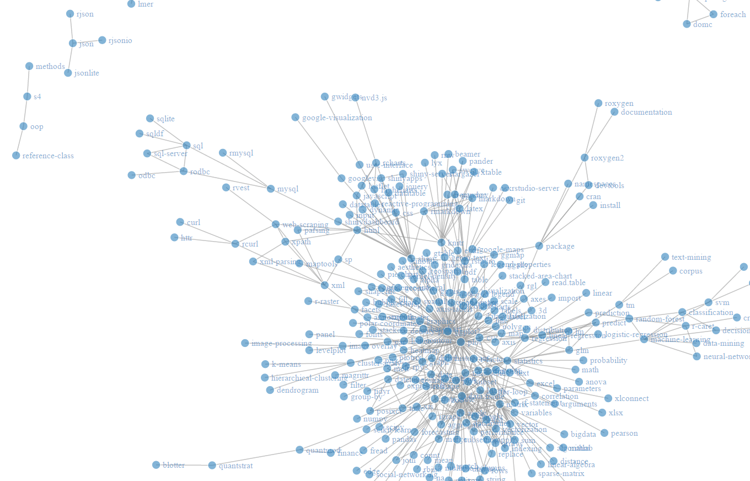

Slide 39
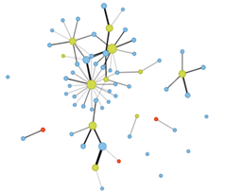
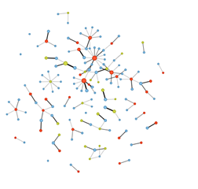
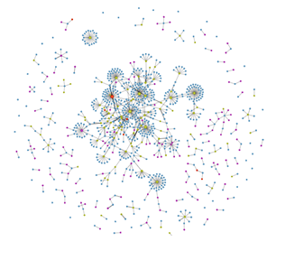
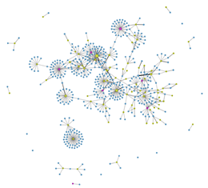
Overall system behavior
Now
multi
dimensional!

Slide 40
WestLaw UK dataset (more than 2000 cases from 2018)
https://www.linkedin.com/pulse/legaltech-data-challenge-legalgeek-daniella-tsar

Slide 41
Net of nets (the internet)
https://www.opte.org/about

Slide 42
REFACTOring long r functions
func_large <- function(a1, a2, b1, b2, c1, c2){
# stuff around a
if (a1 > a2){
a_output <- "foo"
} else {
a_output <- "bar"
}
# stuff around b
...
# stuff around c
...
return_thingie <- list(a_output,
b_output,
c_output)
return(return_thingie)
}
func_a <- function(a1, a2){
# stuff around a
if (a1 > a2){
a_output <- "foo"
} else {
a_output <- "bar"
}
return(a_output)
}
func_b <- function(b1, b2){...}
func_c <- function(c1, c2){...}
From | To
Inputs | Body
Body | outputs

Slide 43
Refactor a large function
Inputs
Body
Outputs

Slide 44
Shinytester
https://github.com/DataStrategist/ShinyTester

Slide 45
Social Network Analysis (SNA) guide from the home office
https://assets.publishing.service.gov.uk/government/uploads/system/uploads/attachment_data/file/491572/socnet_howto.pdf

Slide 46
Wheat PEDIGREE
PI FEDERAL = AU//KAL/BB///WOP

Slide 47
Wheat PEDIGREE
KAL BB
KAL/BB
AU//KAL/BB
AU
WOP
PI FEDERAL = AU//KAL/BB///WOP

Slide 48
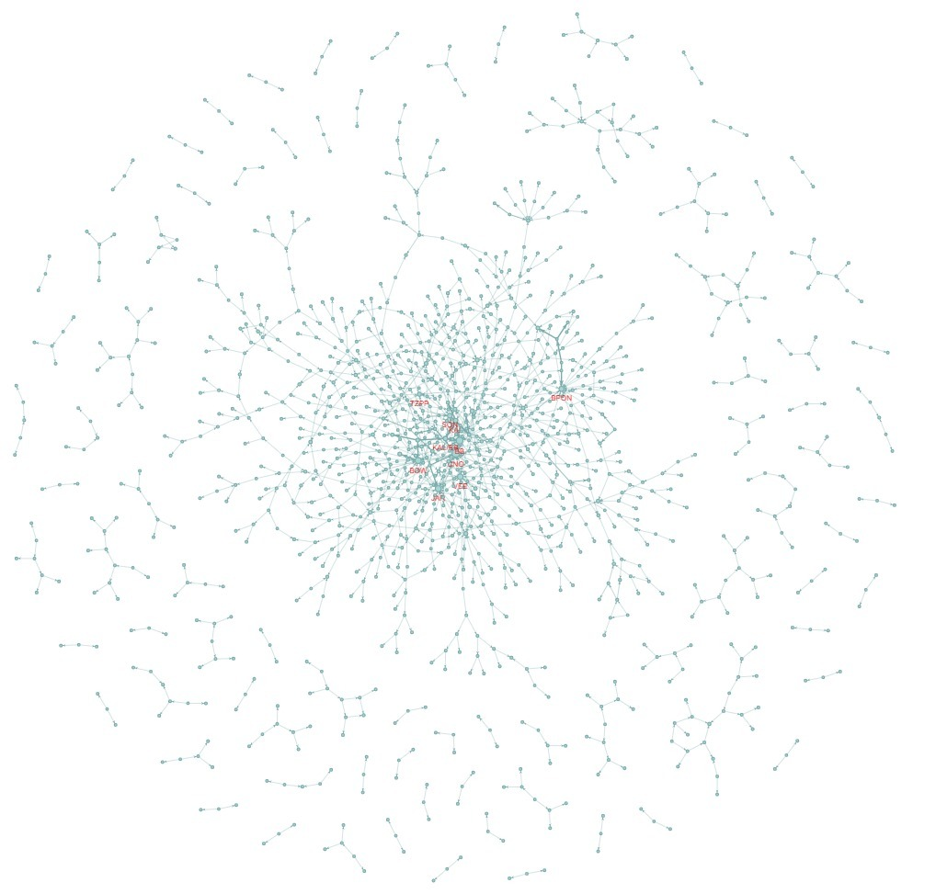
PEDIGREE map
PI FEDERAL = AU//KAL/BB///WOP

Slide 49
Conclusions
Network analysis provides a unique lens to view the world
Networks are everywhere
Network analysis is more than pretty pictures

Slide 50
THANK YOU
AMIT KOHLI
FREELANCE DATA CONSULTANT
data@amitkohli.com
Amit Kohli Consulting
amitkohli.com

Slide 51
Goodie BASKET
https://www.jessesadler.com/post/network-analysis-with-r/
https://www.youtube.com/watch?v=2ZHuj8uBinM&ab_channel=TheAlanTuringInstitute
https://www.youtube.com/watch?v=L6CqqlILBCI&ab_channel=TheAlanTuringInstitute
https://towardsdatascience.com/how-to-get-started-with-social-network-analysis-6d527685d374
https://www.slideshare.net/dnac2017/tuesday-morning-lecture-descriptive-statistics
https://www.youtube.com/watch?v=Eu3uv__BagE&t=364s&ab_channel=ThomsonReuters
https://www.r-project.org/nosvn/conferences/useR-2010/slides/Zhang.pdf
https://s3.amazonaws.com/assets.datacamp.com/production/course_6675/slides/chapter1.pdf
http://web.stanford.edu/class/cs224w/
https://sites.fas.harvard.edu/~airoldi/pub/books/BookDraft-CsardiNepuszAiroldi2016.pdf
https://cheatography.com/trvoldemort/cheat-sheets/igraph/
file:///C:/Users/mexin/Downloads/sampling-kdd06.pdf

